Slide 1
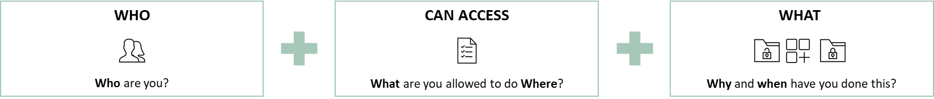
Enterprise IAM transformation
An approved initiative through the Approval Board
The Enterprise IAM Transformation
Minimize Operational Security Risks
Scope:
Identity and access lifecycle management for all enterprise user categories (human and non-human) throughout the organization.
A combination of self-service capabilities and automation.
Access review capabilities to ensure auditability and compliance.
How it will be achieved:
Onboarding and set-up in value drops (see next slide for more information) focusing on specific user categories and / or capabilities. We have created an approach enabling continued value realization.
Implementation and utilization of a new Enterprise IAM SaaS system to have the required technical support to be able to enforce this.
Why do we need it?
The Enterprise IAM transformation is required to minimize the current operational security risks identified as one of the most critical risk themes reported by BT to Corporate Governance as well as acting as an enabler for the core business.
A holistic view of who has access to what and automated processes and governance to reduce risks.
By ensuring visibility we can meet compliance requirements.
Accounts and accesses are disabled after leaving (not being done in many cases today).
Avoid fines related to GDPR and data breaches
Value realization
Business Benefits
Automation and self-service capabilities to reduce onboarding lead times in a secure manner.
Enabling all store workers to access current and future tools required to be able to meet customer needs.
Enterprise IAM is identified as one of the most important enablers for the “Store Employee Empowerment” journey which is part of the “Seamless Customer Journey”.
Key of the H&M transition to a Zero Trust architecture
What is Identity & Access Management?
Identity and Access Management (IAM) is a fundamental building block for enabling security throughout the organization

Slide 2
“We have lost control of who has access to our business data and personal data - a new IAM platform and transformation is required”
Example of current security risks at H&M
What does this mean?
200 000 active AD groups
(An AD group usually represents a user category for an application)
45 different ways of getting access to one of the applications in the tier 0 list
(Applications should have one standardized way of managing access)
No control of 10 000 services accounts
(Service accounts often have administrative access to applications)
27 000 – 35 000 accounts granting access to unidentified users to unknown resources
Examples of potential outcome
GDPR fine*
Up to 4% of total global turnover, or
EUR 20 million
Data breaches**
Disclosure of personal information,
EUR 82-212 million
Ransomware attack**
SAP System failure, EUR 105 million (with assumed recovery in 72h)
Disabled distribution centers EUR 70-100 million
*GDPR Info EU
**H&M specific numbers from Cyber insurance

Slide 3
Value Drops
A long side the ten identified value drops, Risk Management reporting and Clean-up activities will be carried out
The goal is to scope the value drops in such a manner that one value drop can be started each PI. The aim is to complete the technical realization of the specific Value Drop (VaD) within one PI, while the migration activities continues, spanning over one or several PIs, depending on the effort required until completed.
The value drops can be re-arranged (to a certain extent) depending on business priorities. Examples of prioritization input:
Decom of IAM Master (due to lack of resilience)
Decom of MIM
Ongoing projects / initiatives (e.g., New POS, One experience etc.)
Changes to the organization
Risk Management Reporting
Value Drop #1
Technical go-live and access visibility. Initiate clean-up activities
Clean-up activities
Value Drop #2
Identity Lifecycle Management of Employees
Value Drop #3
Transformation of rule-based access
Value Drop #4
Identity Lifecycle Management of Contingent Workforce
Value Drop #5
Cont. migration of Identity LCM and addition of new functionality
A Value Drop consist of several aspects:
Functional and technical as-is analysis
Functional to-be design ensuring best practices, self-service and automation
Technical design and implementation realizing the functional design
Change management activities when required, especially when there is an end-user impact related to a value drop
Knowledge transfer and handover to Operations team
All design and implementation is documented on our Confluence page.
For end-user information, visit the Enterprise IAM Transformation SharePoint site.
Value Drop #6
Identity Lifecycle Management of MSP and suppliers (excl. the supplier portal)
Value Drop #7
Processes and ownership structure to facilitate request-based access control
Value Drop #8
New integration and migration from IAM Master
Value Drop #9
Identity Lifecycle Management of Things
Value Drop #10
Foundational functionality for SAP and plan forward

Slide 4
2024
2025
2026
Q1
Dec - Feb
Q2
Mar - May
Q3
June - Aug
Q4
Sep - Nov
Freeze period
Q1
Dec - Feb
Q2
Mar - May
Q3
June - Aug
Q4
Sep - Nov
Freeze period
Q1
Dec - Feb
Q2
Mar - May
Value Drop #1
Value Drop #3
Migration of relevant consistent rules and potential addition of new
Technical go-live and access visibility. Initiate clean-up activities
Transformation of rule-based access
Value Drop #4
Not determined: Migration of existing Contingent Workforce to PD and connecting HR record to existing AD account (major dependency towards other teams)
Value Drop #2
Identity Lifecycle Management of Contingent Workforce
Identity Lifecycle Management of Employees
Value Drop #5
Value Drop #6
Migration of MSP and suppliers to new solution
INTERIM AD MANAGED ACCOUNTS SOLUTION & MIGRATION
Identity Lifecycle Management of MSP and suppliers (excl. the supplier portal)
Value Drop #10
Value Drop #11
Value Drop #7
Migration of Things
Improvements / Enhancements
Foundational functionality for SAP and plan forward
Identity Lifecycle Management of Things
License mgmt.
Value Drop #8a
Value Drop #8b
Foundational technical realization of request based ALM and migration of UA scope
Change in WoW related to ALM (e.g. store)
Value Drop #9
Switch-over to new integration
New integration and migration from IAM Master
Clean-up activities
Change Management activities
Risk Management Reporting

Slide 5
Proposed team setup for the Enterprise IAM Transformation for Jan-Nov 2025
To enable a more collaborative approach, select roles will transition* to H&M, with a gradual scale-down and a recommendation to shift the change enablement function to the Culture & Competence Unit to better support upcoming impactful deliverables.
Project Management
Project Manager
Solution Lead/Architect
Functional Lead
Technical Lead
BOT function
Functional Analyst
Saviynt SME / Scrum
Saviynt Dev
Change Enablement (Culture & Competence)
Functional Analyst
Back-end Dev
Saviynt Dev
Functional Analyst
Clean-up & Sav Campaigns
Saviynt Dev
H&M
Accenture
Functional Analyst
Senior Saviynt SME
Saviynt Dev
Out of scope compared to current set-up
*The FTE transition is visualized on the next slide.

Slide 6
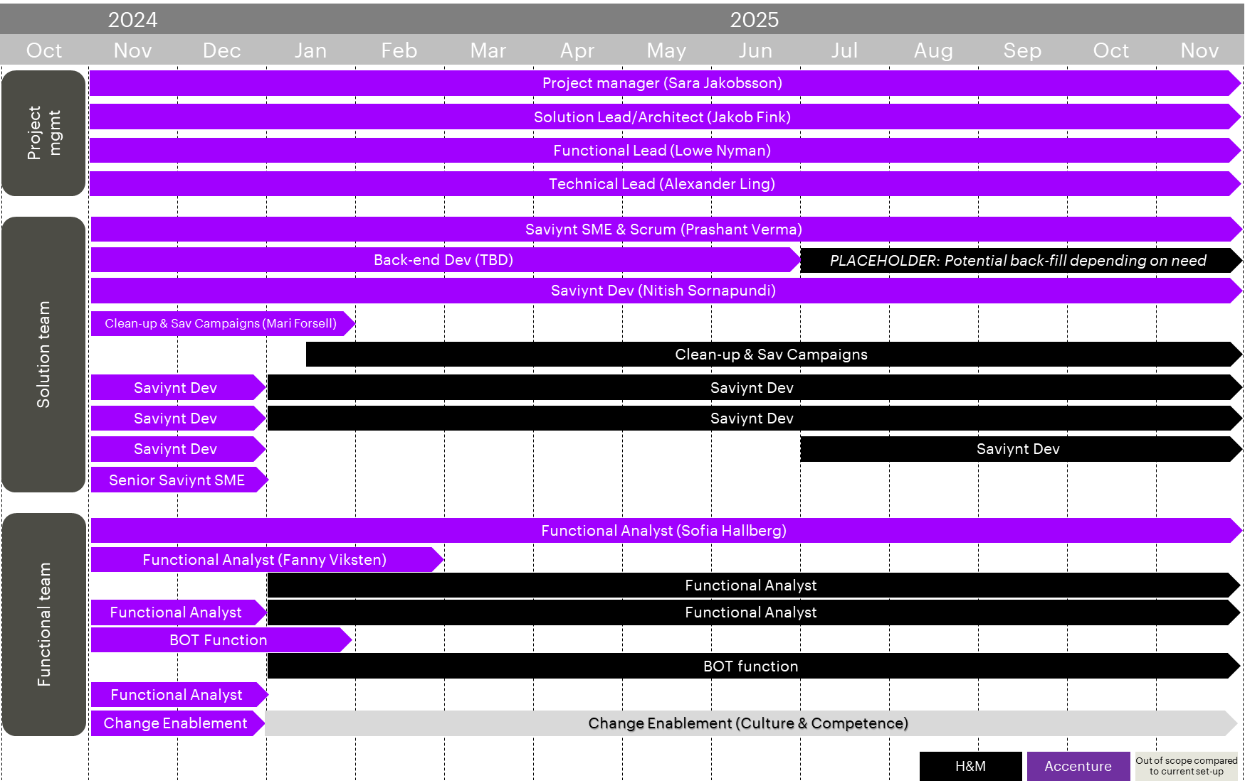
To limit impact of a team change we suggest a phased approach to transitioned over time

Slide 7
IAM Transformation resource plan and ramp-down during FY25 reducing Accenture spend by 60%
No of resources
13,4 FTEs
Approx. x MSEK / month average cost excl. H&M resource
13,4 FTEs
Approx. x MSEK / month average cost excl. H&M resource
16,6 FTEs
Approx. x MSEK / month
Project Management
Project Management
Project Management
Solution stream
Solution stream
Solution stream
Functional stream
Functional stream
Functional stream
Current set-up
First ramp-down
Second ramp-down
Time
Until end of December
Decrease of the number of resources and start transition to H&M resources
Until end of February
Continue the transition to H&M resources
Until end of November
Oct
2024
Dec
2024
Feb
2025
Nov
2025
H&M
Accenture

Slide 8
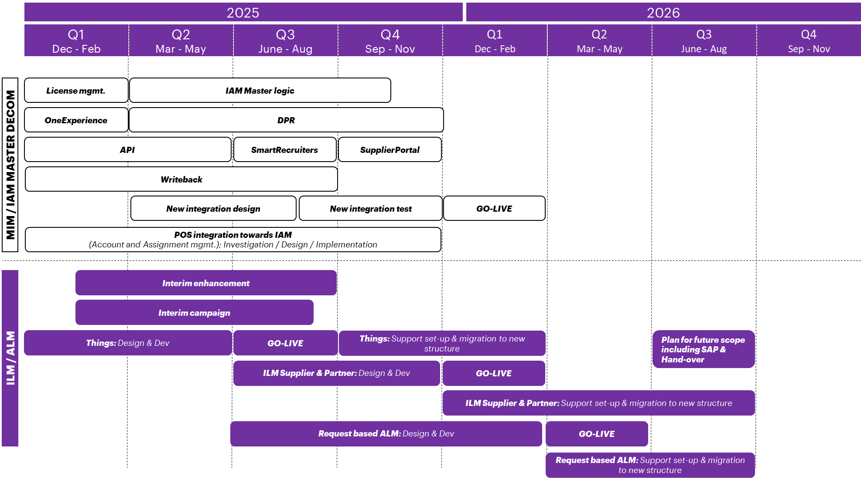
Suggested roadmap based on new team set-up and reduction of enterprise risks
Compared to current roadmap, we estimate a PI delay due to changes in the team.

